Slide 1

Voltorb august 2021

Slide 2
PROBLEM STATEMENT
Voltorb - August 2022
Rahul bought a new house, his water gets wasted and leaks his walls when his tank overflows, he seeks a help from you to design a circuit that turns off motor when water the tank overflows. And also to display water level of tank in a panel.
Create a system that has following functionalities
• Turns off motor when water level reaches a set point.
• System should return to normal state when water level is below a set level.
• Water level of tank should be displayed as LOW MED FULL in LEDs.
Instructions:
Use of microcontroller is not allowed.
Additional functionality and creativity attracts more points.
Both physical and simulation circuits are accepted.

Slide 3
COMPONENETS REQUIRED
Si No | Components | Units
1 | Transistor BC547 | 4
2 | Diodes | 1
3 | Relay switch | 1
4 | LEDs (Red, Yellow, Green) | 3
5 | Resistors 1k | 1
6 | Resistors 220 ohm | 3
7 | wires | As per req

Slide 4
Solution
Procedure:
A probe should be connected as input to BC547 amp circuit.
Relay coil should be connected to output.
Motor should be series with Relay NC and COM.
Function:
When the probe doesn’t touches water no current passes through base and Coil is set OFF hence the Relay makes the contact of main motor hence the relay is NC the motor is turned ON by operator.
When the probe touches water low current passes through base and Coil is set ON hence the Relay brakes the contact of main motor, Hence motor doesn’t start even if user starts motor.

Slide 5
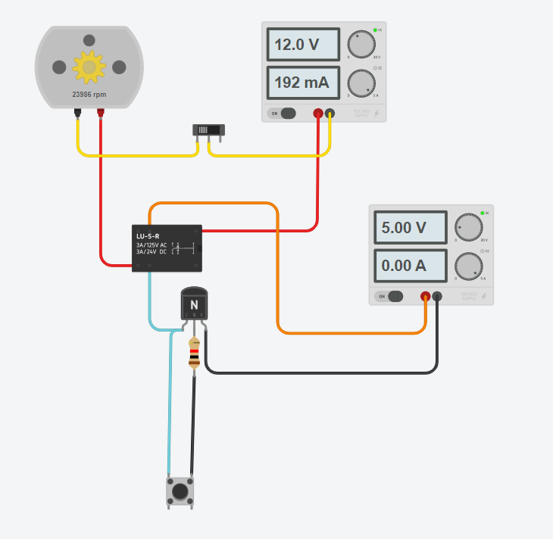

Slide 6
Solution
Procedure:
A probe should be connected as input to BC547 amp circuit.
Make similar 3 different circuits
LEDs coil should be connected to output.
Function:
When the probe doesn’t touches water no current passes through base and LED is off indicating no presence of water at the level.
When the probe touches water current passes through base and LED is ON indicating presence of water at the level.

Slide 7
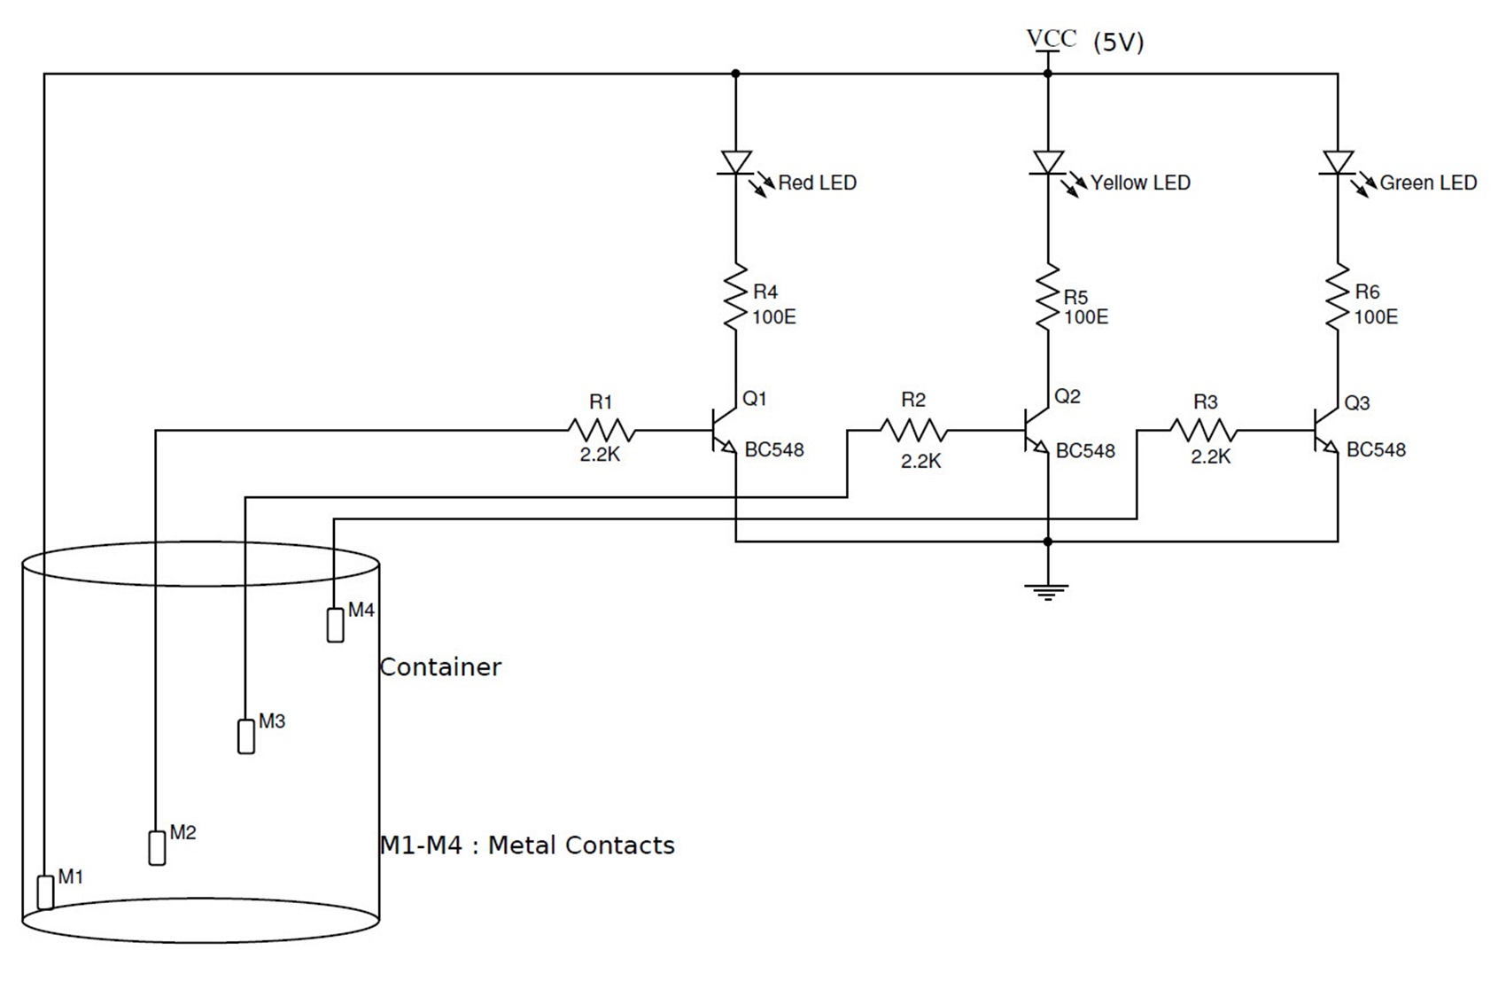

Slide 8
THANK YOU
IEEE UVCE PES
For queries
Write to us at ieeeuvcepes@gmail.com

